Slide 1
Business Center Monitoring System
Period: 24th June – 2nd August

Slide 2
Project description
Create a system that monitors some rooms or offices by gathering data from sensors (temperature/humidity, ultrasonic, infrared, light) and capturing photos using a webcam.
The system may create statistics from the collected data that can be visualized on a webpage

Slide 3
Features
The system shall be able to read data from sensors
Processed data shall be saved in a database
The system shall be able to take pictures when someone enters/exists the room
The system shall provide a user interface (show data, picture, statistics, etc.)
The system shall create statistics (charts) based on the collected data
Documentation (see on the next slides)

Slide 4
Additional features (if time allows it)
Use of a GSM module in order to send notifications when motion is detected, temperature/humidity is out of bounds, etc.
Write automated tests

Slide 5
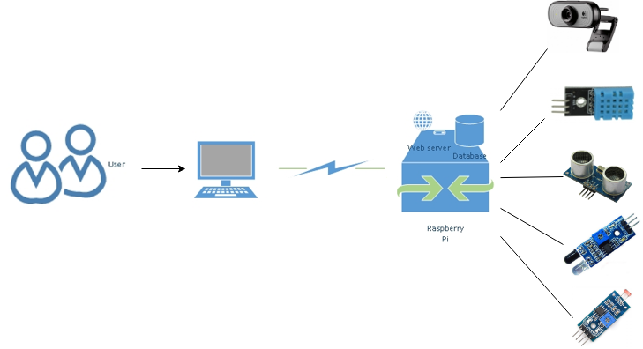
First system proposal

Slide 6
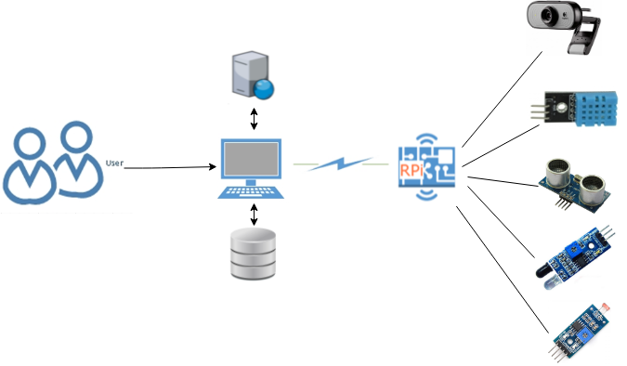
Second system proposal

Slide 7
Planning – agile methodologies
Daily stand-up – meeting where talk about the previous day; what was done, what problems did we encounter and what is the plan for the current day
Backlog – a prioritized features list; can also contain bugs, improvement ideas, knowledge sharing
Sprints – 1 or 2 week slots that the project is divided into (most probably will be 1 week)
Tasks – we will use a project management tool
Sprint retrospective – a meeting where we talk about problems, what went well in the finished sprint and what can be improved
Sprint review- a meeting at the end of a sprint where we talk about what was implemented in the sprint, what is the remaining work, etc.
Sprint planning – meeting where we plan the next sprint, what will be done
Demo – show the team what it has done (at least 2 demos)

Slide 8
Source code and documentation
Documentation
System Architecture Specification
Component specification
User manual/Readme, HowTo, etc.
Source code
Version control tool: innersource.accenture.com
Coding standards – to be defined for all languages that we will use
Tools and input resources
Place under version control all the resources used
Document all the tools used

